Slide 1


AQUA Project

Slide 2


OUR TEAM
Yoana Stoyanova
Ivan Staev
Marieta Stoycheva
Magdalena Omayska

Slide 3



STAGES OF REALIZATION
1ST STAGE - PLANNING
2ND STAGE - REALIZATION
3RD STAGE - PRESENTATION

Slide 4








LANGUAGES AND TOOLS

Slide 5
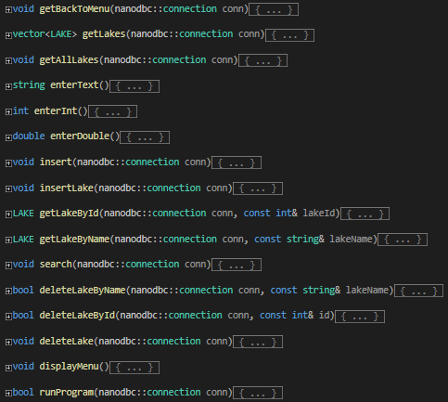
OUR FUNCTIONS AND MORE ABOUT THE PROJECT

Slide 6
THANK YOU FOR YOUR ATTENTION!

Slide 7
ANY QUESTIONS?

